Slide 1

Group-3 (Batch-2) Comprehensive Retail Sales Analysis
Group Members
Nimish Birla
Nirati Khanna
Saumya Gupta
Shyam Tibrewal
Siddhi Saxena

Slide 2
Problem Statement
- In the realm of retail, making informed decisions based on historical data is crucial. The challenge arises when strategic choices are influenced by limited historical records, especially for events that occur annually, such as holidays and major promotions.
This challenge is exacerbated by the fact that significant events, like holidays and markdowns, have a considerable impact on sales, making it necessary to anticipate the effects on specific departments and overall performance.
This project focuses on leveraging historical sales data to engineer a data-driven solution for the company's decision-making processes.
The dataset encompasses sales data from 45 stores distributed across various regions, each housing multiple departments.
The company's operational strategy includes several promotional markdown events, each aligned with key holidays like the Super Bowl, Labour Day, Thanksgiving, and Christmas.
Worth noting is the fact that week’s containing these holidays hold five times the significance of non-holiday weeks during evaluations

Slide 3
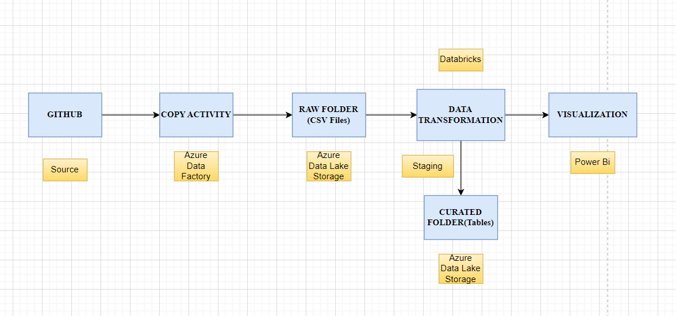
Data Flow Diagram

Slide 4
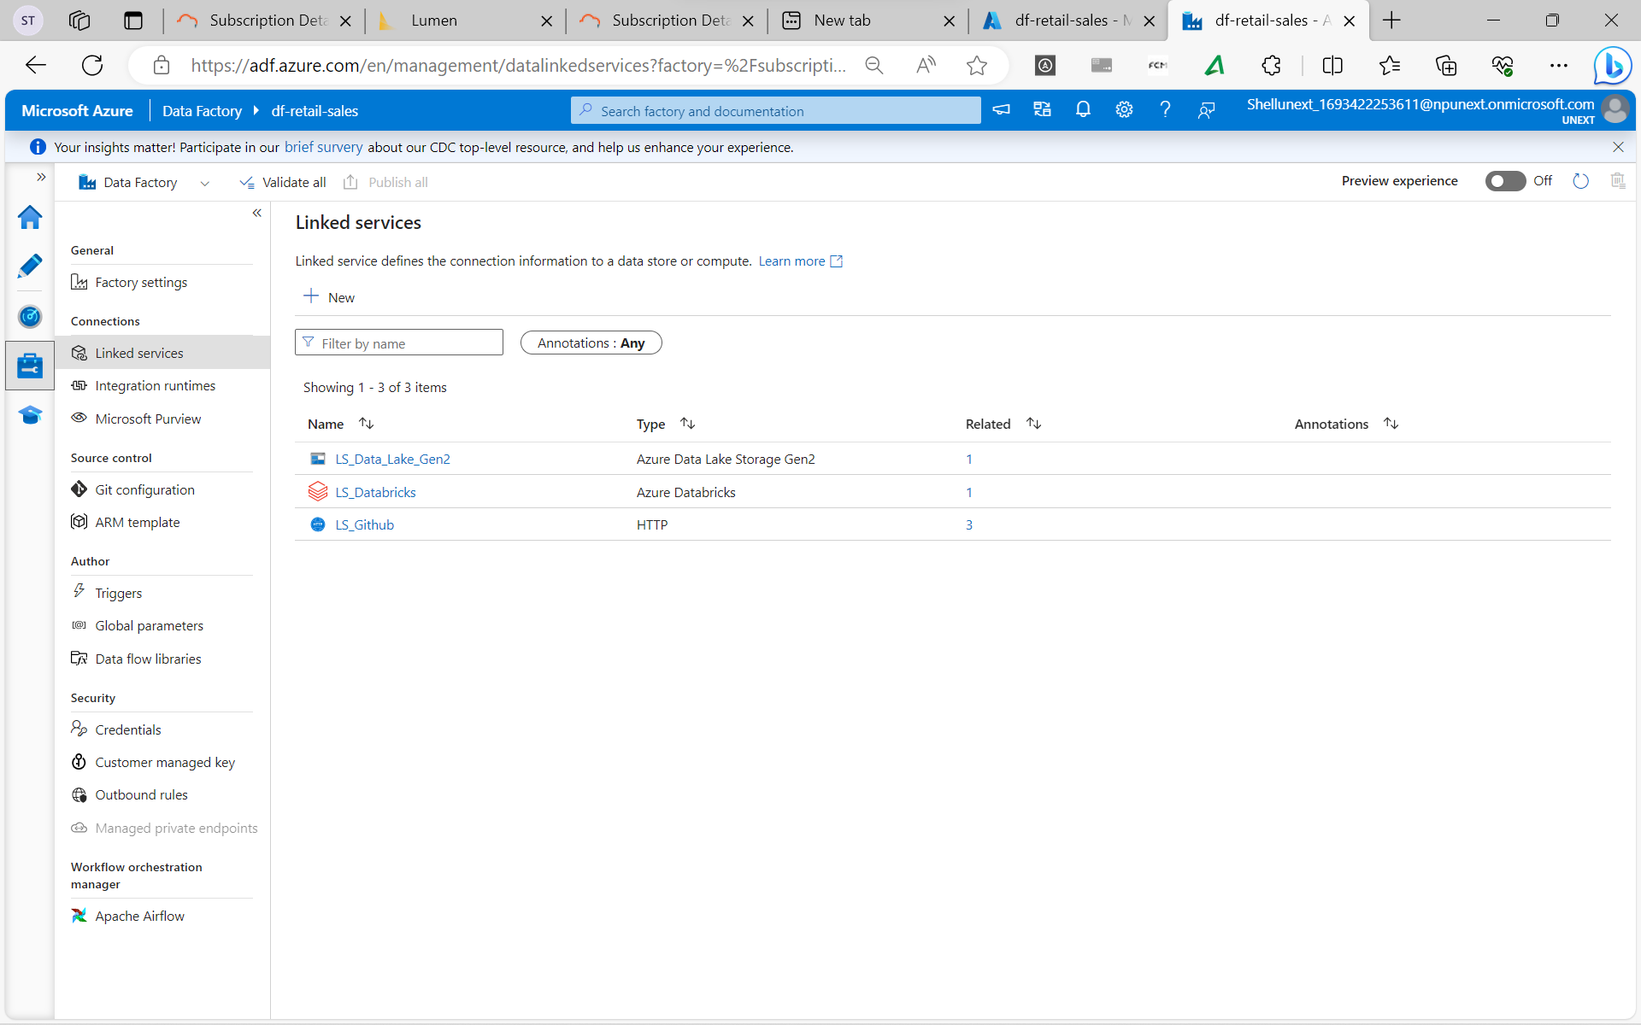
Snapshots of developments in RAW layer

Slide 5
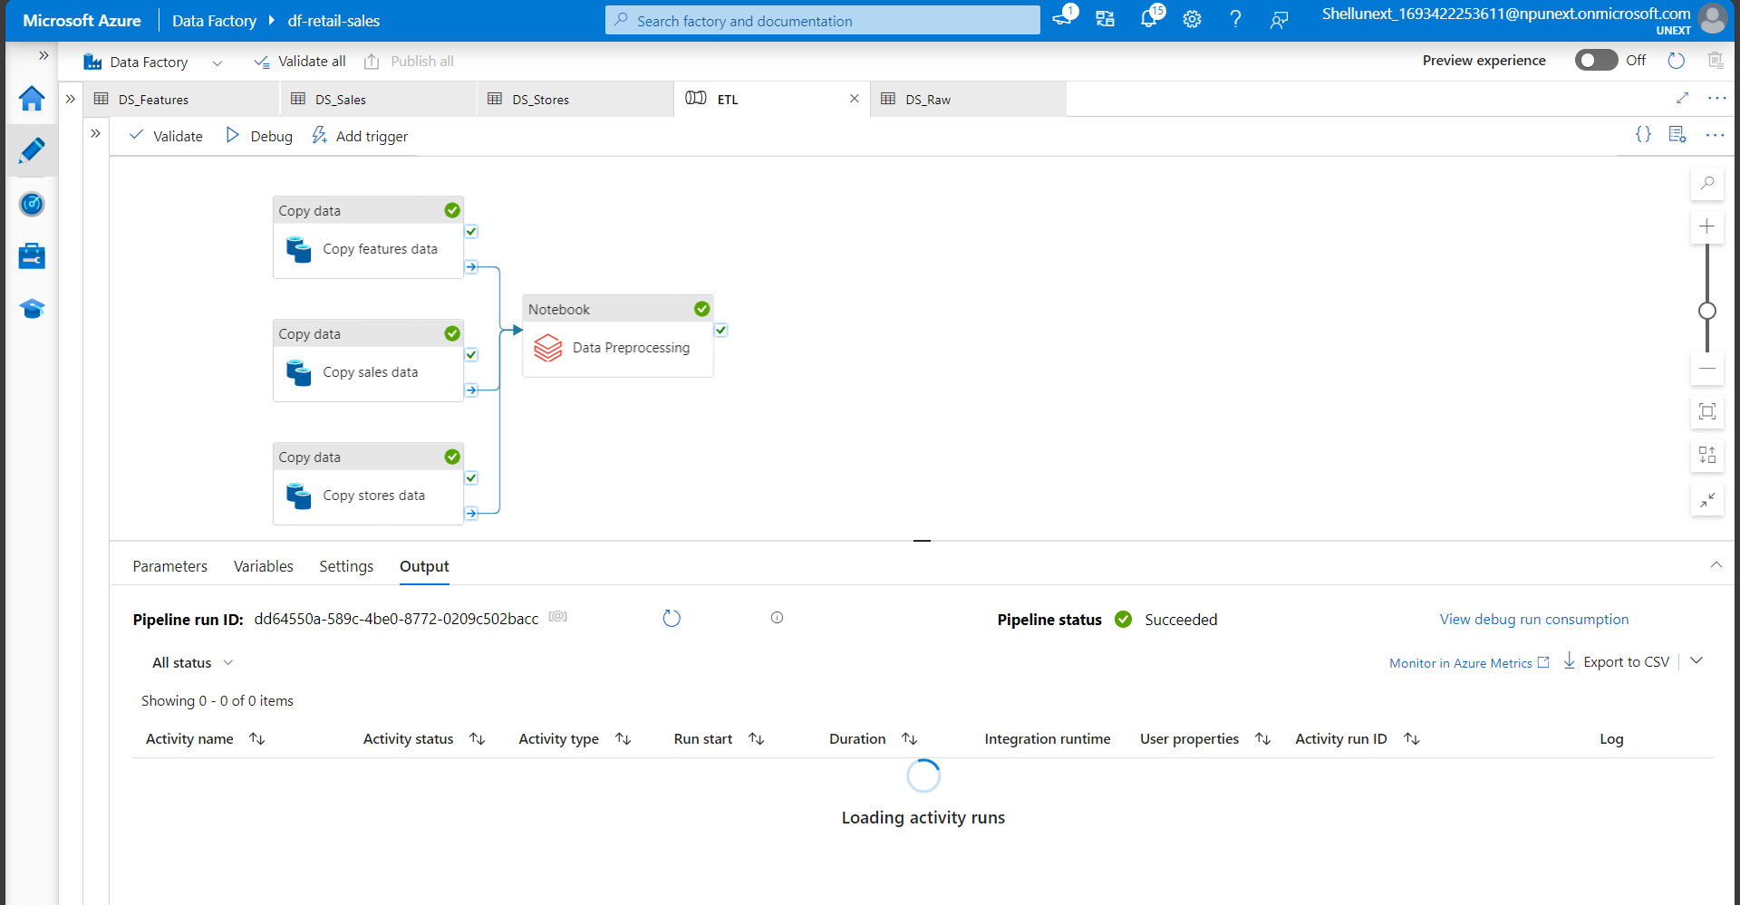
Snapshots of pipelines in STAGING(STG) layer

Slide 6
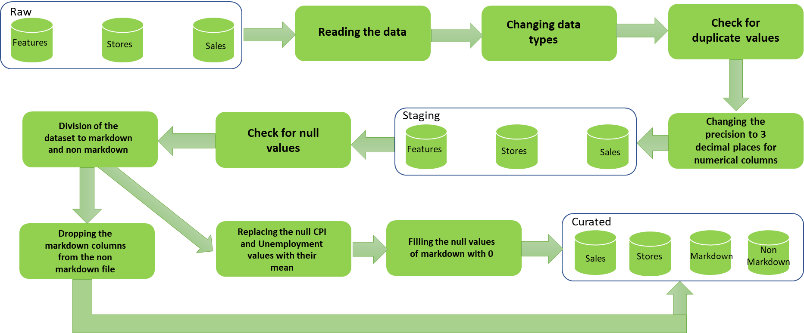
Flow of data preprocessing & data transformation

Slide 7
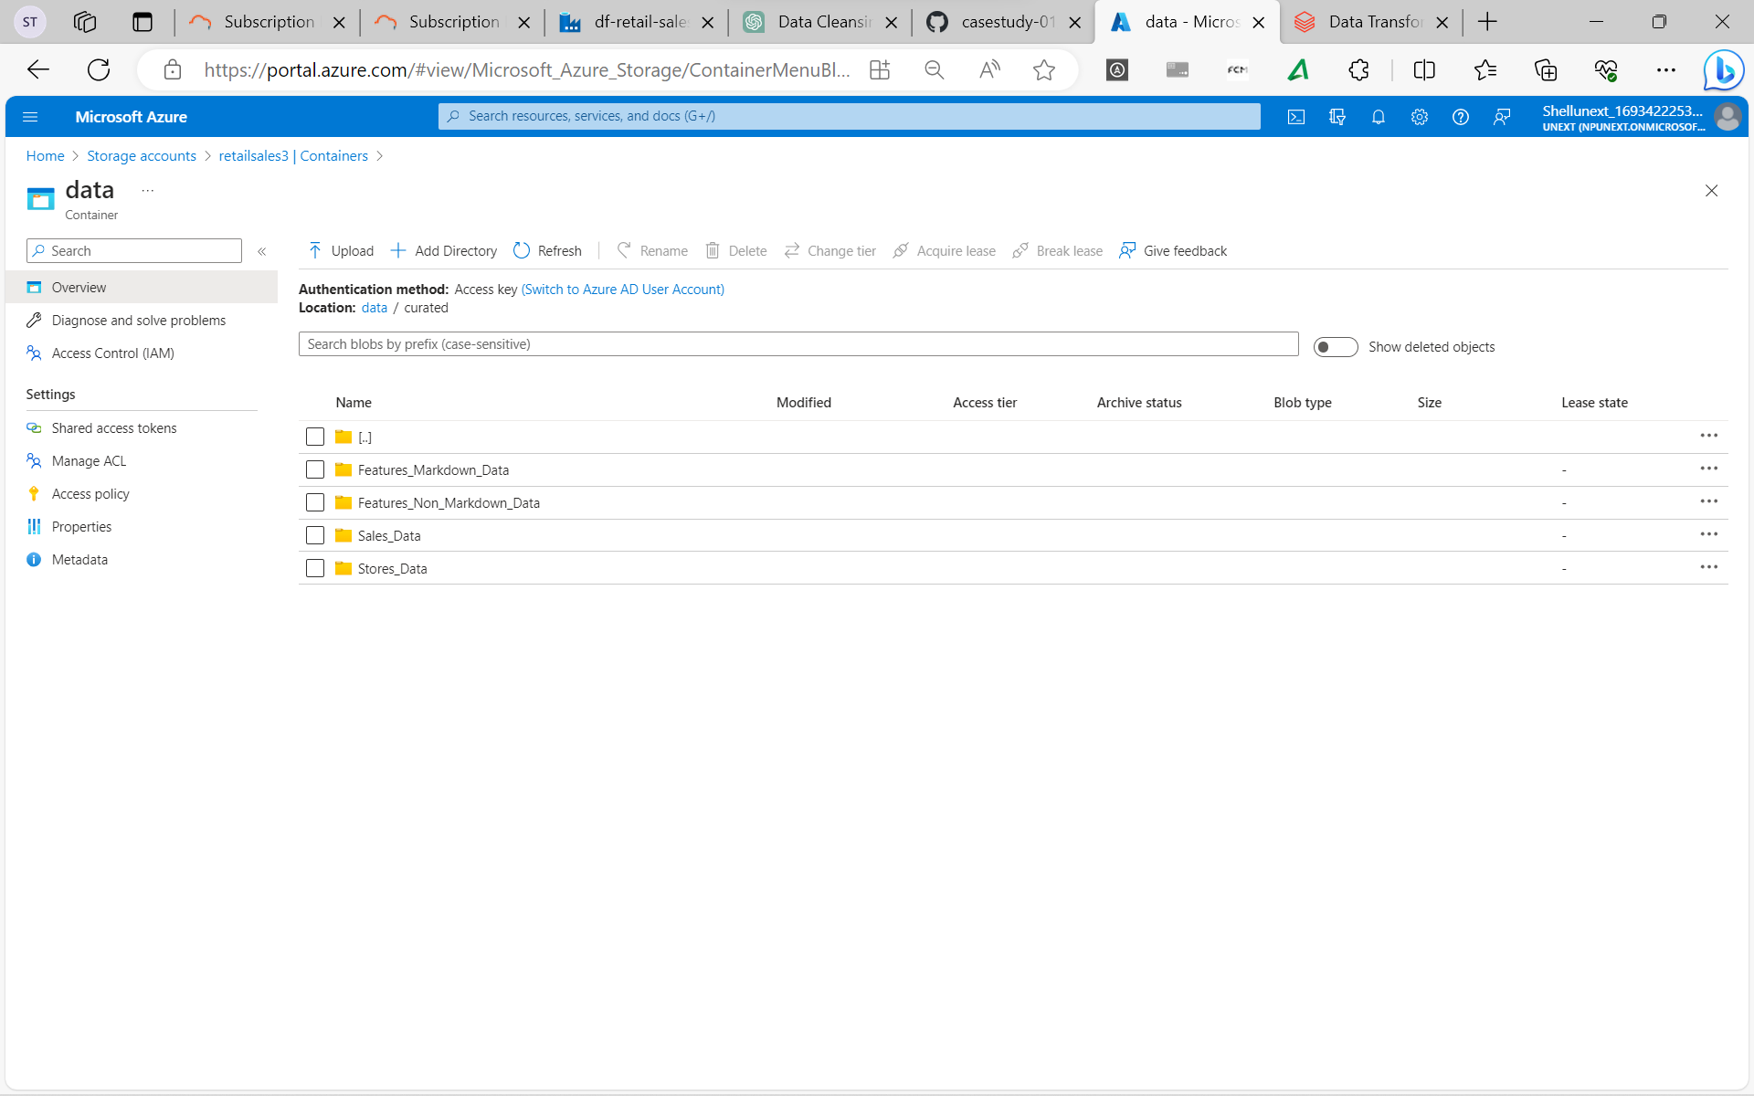
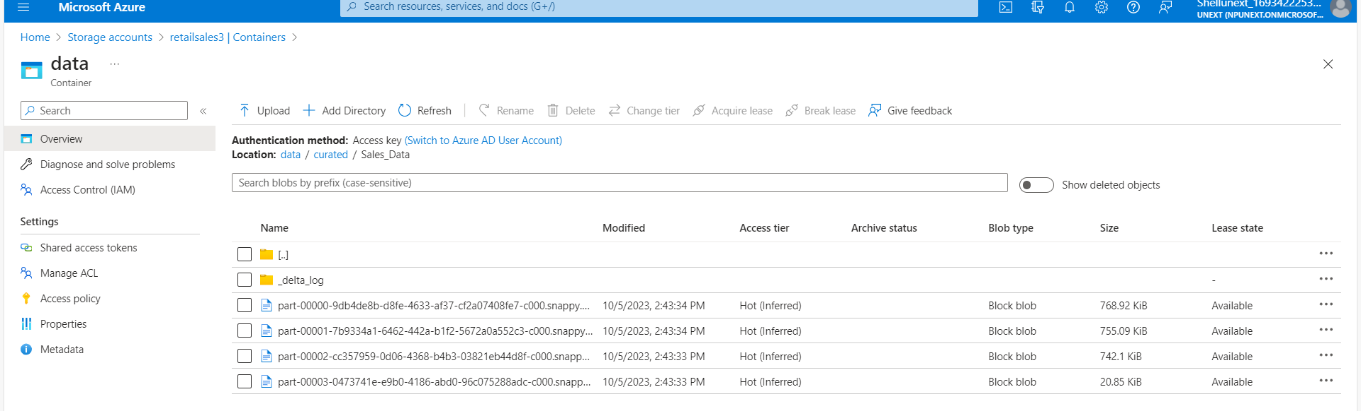
Snapshots of developments in CURATED layer

Slide 8
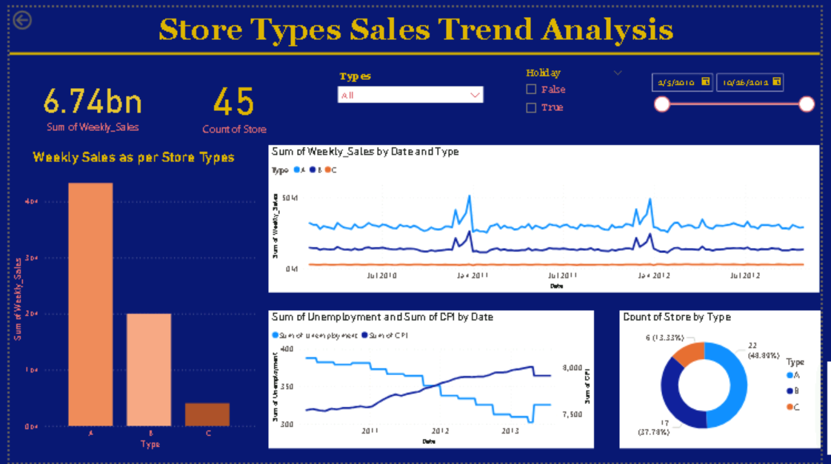

Slide 9
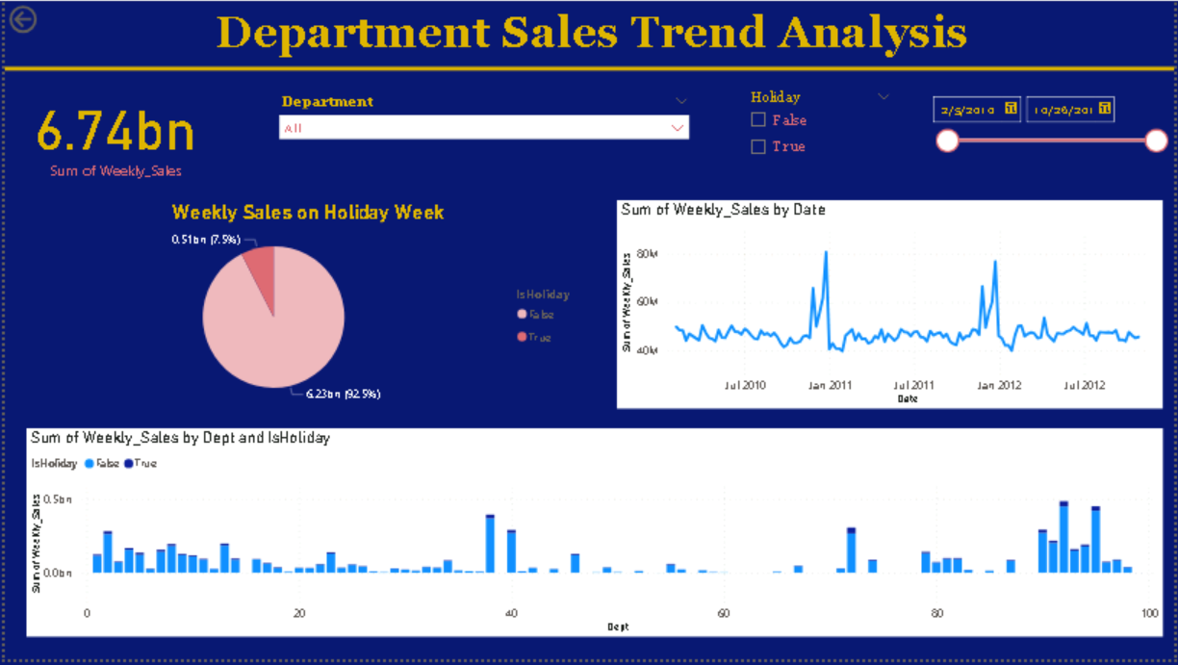

Slide 10
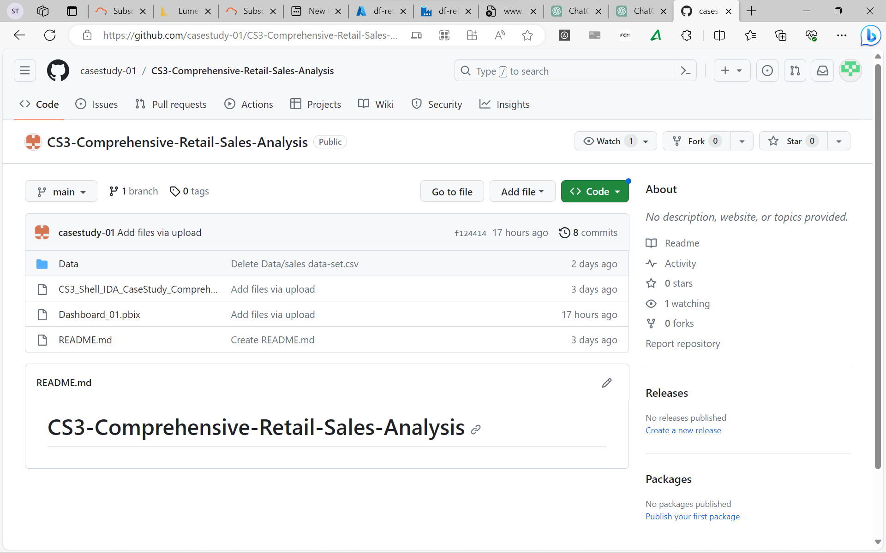
GitHub link
https://github.com/casestudy-01/CS3-Comprehensive-Retail-Sales-Analysis

Slide 11
System Demo

Slide 12
Q&A

Slide 13
Challenges faced
Creating Dashboard in PowerBi
Handling Markdown Column Data in Features Dataset
Connection of Databricks to PowerBI

Slide 14
Learnings
Team Work
Time Management

